Slide 1
The INTOSAI Working Group on Public Procurement Audit
4th July 2017
SAI OF PORTUGAL
UPDATE

Slide 2
TdC Public Procurement Audit 2016/17
Health care (medicines, food, imaging and medical services)
Water supply sector
Additional contracts
Relations between local authorities and local companies

Slide 3
TdC Public Procurement Audit 2016/17
Results
Inadequate procurement planning
Non competitive procedures (ex: too many direct awarding, ilegal in house providing)
Non compliance of procurement rules (incl. publicity)
Unsuitable award criteria
Poor internal control procedures

Slide 4
TdC Public Procurement Audit 2016/17
Results
Illegal or inefficient central purchasing
Nearly 50% of contracts are subject to changes
Lack of justification for changes
Illegal additional works
Many expenses deriving from arbitration courts’ decisions

Slide 5
TdC Public Procurement Audit 2016/17
Challenges
Centralised purchasing
Following-up recommendations
New legislation
Arbitration cases
Measuring benefits of public procurement in environmental, social and innovation policies
Preventing corruption

Slide 6
Public Procurement new legislation
New European Directives on public procurement
Directive 2014/24/EU on public procurement
Directive 2014/25/EU on procurement by entities operating in the water, energy, transport and postal services sectors
Directive 2014/23/EU on the award of concession contracts
New Public Procurement Code

Slide 7
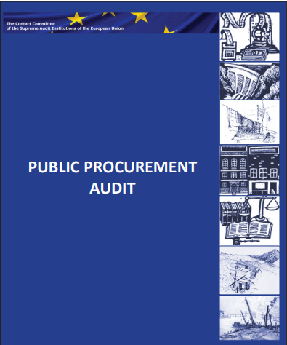
EU Contact Committee
Public Procurement Audit

Slide 8
EU Contact Committee
Public Procurement Audit
Guideline for Auditors, based on the EU Public Sector Procurement Directive 2004/18/EC and including summaries of the most important judgments of the European Court of Justice
Procurement Performance Model, including key questions developed as reference pointers for auditors evaluating the performance of the procurement function in public sector bodies
Checklists for Financial and Compliance Audit of Public Procurement, to be used when auditing public procurement processes. The checklist is relevant and applicable to auditors operating within different frameworks and with different objectives, requirements and procedures and includes fraud and corruption risks
Summaries of audit reports published by EU SAIs

Slide 9
EU Contact Committee
Public Procurement Audit
2017 UPDATE
SAIs:
Belgium | Latvia
Croatia | Lithuania
Czech Republic | Poland
ECA | Portugal
Finland | Romania
Greece | Slovak Republic
Ireland

Slide 10
EU Public Procurement Audit 2017
Main Changes
EFFICIENCY
More eProcurement (mandatory by 2018)
Simpler access to markets (ESPD, limits to qualifications required)
Easier participation for SMEs (division into lots, subcontractors)
Simpler procedures
More centralised purchases
Public-public cooperation

Slide 11
EU Public Procurement Audit 2017
Main Changes
VFM
Evaluation of past performance
VFM award criteria (best quality-price ratio, life-cycle cost)
Preliminary market consultations
More negotiation
More partnerships
Cross border joint procurement
New rules on concessions

Slide 12
EU Public Procurement Audit 2017
Main Changes
SOCIETAL CHALLENGES
Environmental, social and labour requirements
Label requirements
Promoting the integration of disadvantaged persons
Simplification of social, cultural and health services procurement

Slide 13
EU Public Procurement Audit 2017
Main Changes
CULTURE OF INTEGRITY
Rules on conflicts of interests
Publicity
Unbiased technical specifications
Equal treatment of bidders in all stages of procurement
Objective evaluation of bids
New rules for modification of contracts
New principle of proportionality

Slide 14
The INTOSAI Working Group on Public Procurement Audit
4th July 2017
THANK YOU

